Slide 1

Airbnb Analysis Project Deck

Slide 2
Part A
How did Covid-19 Affect Airbnb?

Slide 3
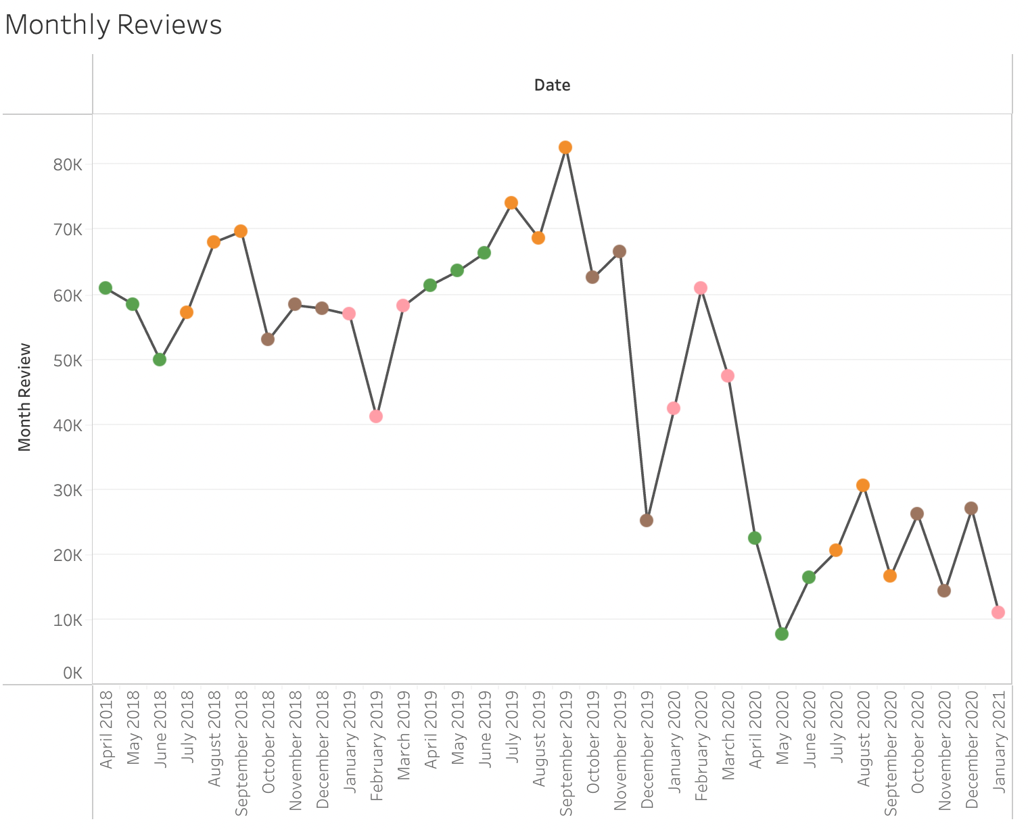
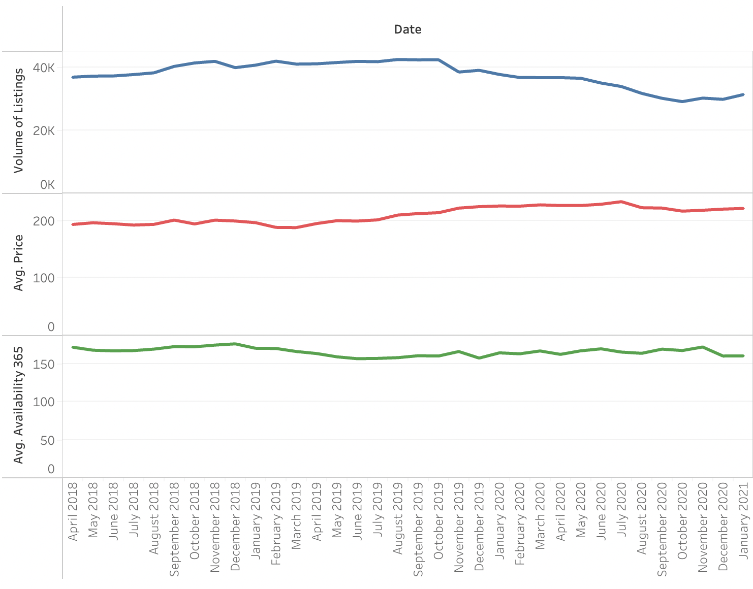
General Change
Monthly Reviews are affected by Covid-19 the most
The volume of listing, avg price, avg availability_365 are not affected too much by Covid-19
The sum of the monthly review decreased by 82.26%(<0.01) after Covid-19
Monthly Review: number_of _review this month - number_of _review last month
Volume of Listings, avg price and avg availability_365
Covid
Covid
Volume of listings decease slightly because of decreasing demands
But listings are less sensitive since disposals of real estates are not easy
Prices increase slightly because of the higher cost of pandemic prevention
But dramatic changes could break market balance, so they didn't happen

Slide 4
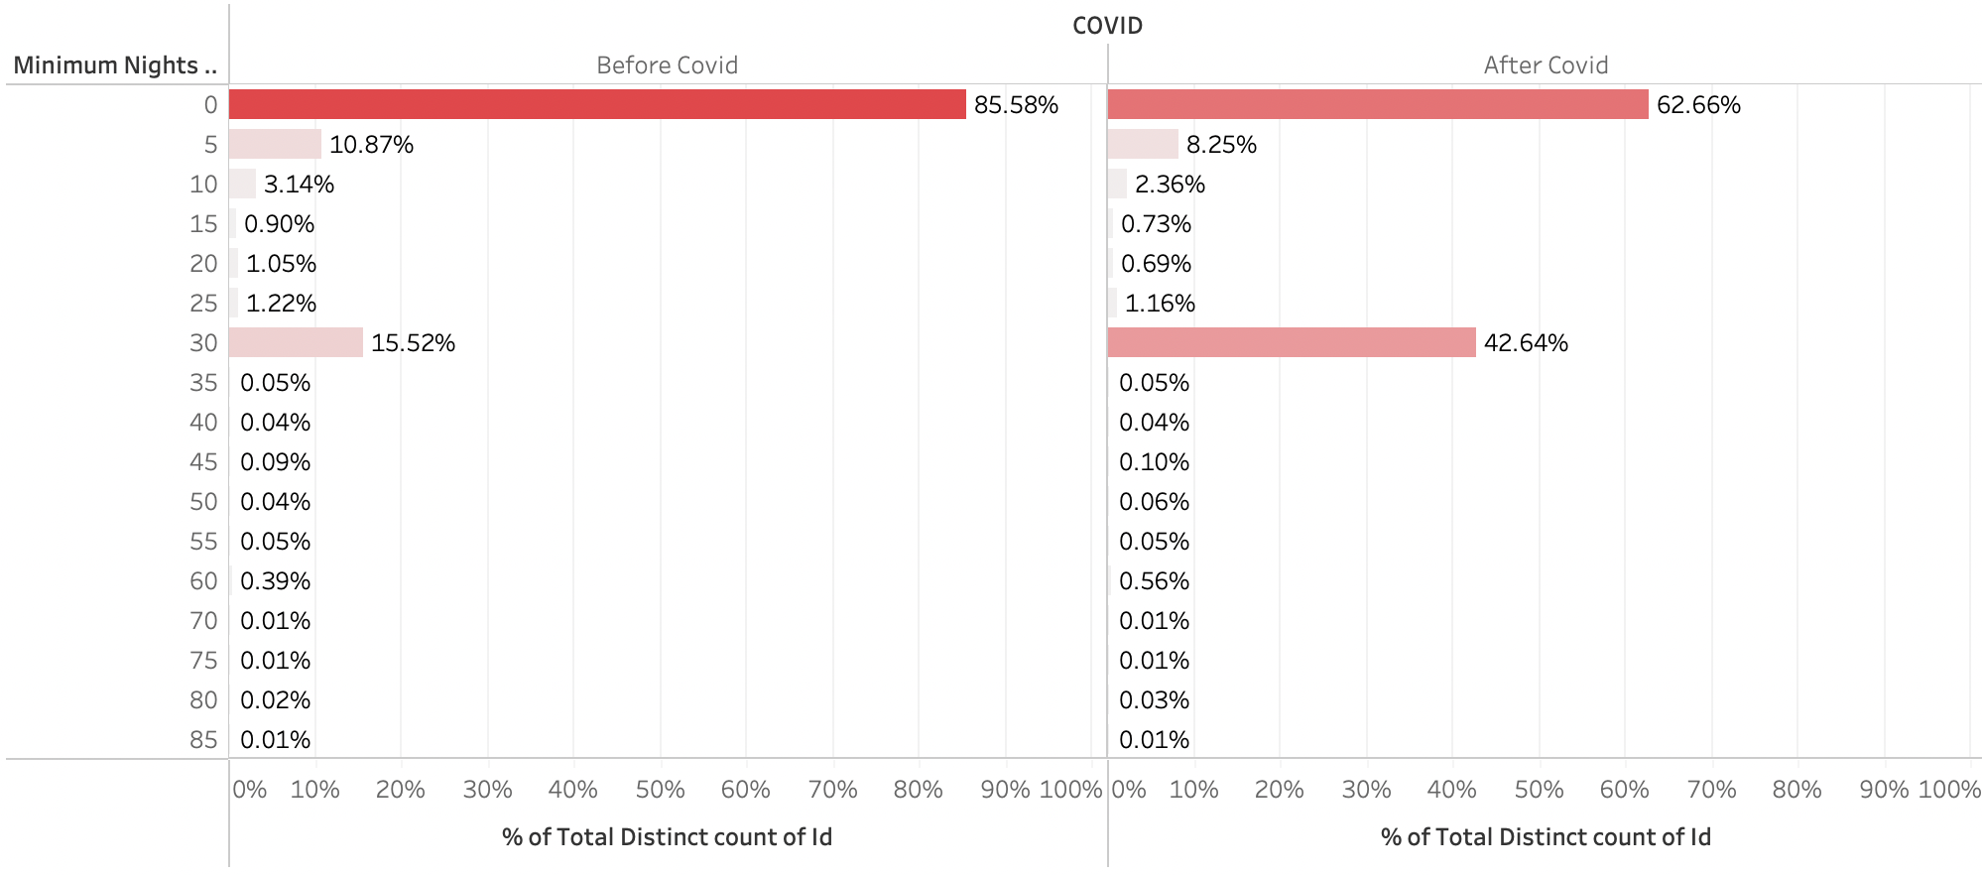
Change of Minimum nights
The Percentage of 30 Days Minimum Nights Increases greatly
Part of short-term leases transfers to long-term leases during covid-19 because of the decreasing number of renters and uncertain epidemic condition

Slide 5
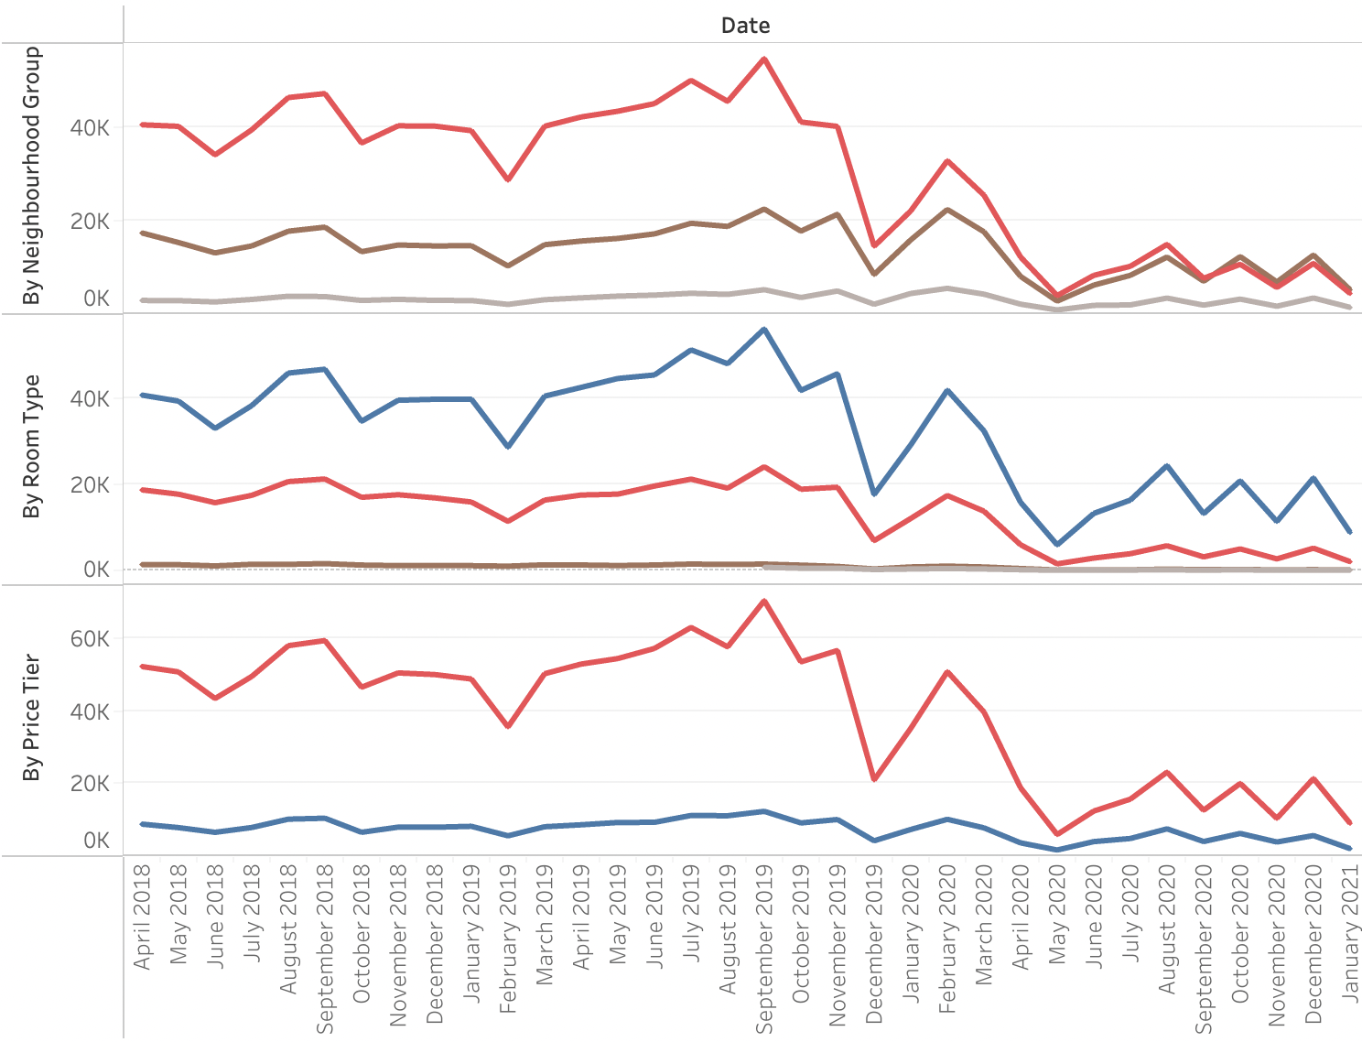
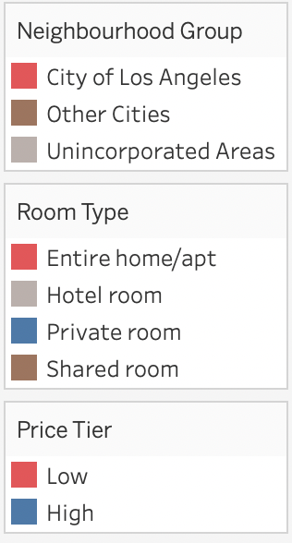
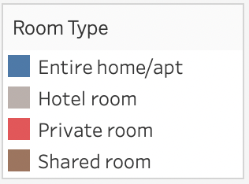
Monthly Review x Neighbourhood_Group/Room_Type/Price Tier
City of Los Angeles, Private room and Low-Price Listings are affected more by Covid-19
The City of Los Angeles is affected more because of the high population, Private room and Low-price listings recover slowly maybe because of the lack of standardized pandemic prevention mechanisms, less promotion and advertising
Monthly Review by Neighbourhood_Group/Room_Type/Price Tier
Covid
 | AVG Change % | P-value
City of Los Angeles | -87.25% | <0.01
Other Cities | -73.33% | <0.01
Unincorporated Areas | -67.49% | <0.01
Entire home/apt | -80.12% | <0.01
Hotel room | -86.89% | <0.01
Private room | -89.50% | <0.01
Shared room | -58.21% | <0.01
Monthly Review
Low | -83.69% | <0.01
High | -73.87% | <0.01
* 200 is the around the total average price of all listings over time
Low-price listings: Avg price over time<=200
High-price listings: Avg price over time>200

Slide 6
Part B
What is the Future Performance of Airbnb?

Slide 7
Model Building & Comparison
XGBoost is the best algorithm among 5 algorithms
Target variable: month_review
Selected Feature: price, minimum_nights, neighborhood_risk, roomtype_risk, Year, Month, drop, covid
Model Building Process
Performance
Data Preprocessing
Aggregation
 | Train MAPE | Test MAPE
Decision Tree | 4.0360% | 144.5443%
XGBoost | 3.0606% | 121.9178%
LightGBM | 0.0089% | 672.8931%
Linear Regression | 17.7913% | 52.1935%
Exponential Smoothing | 15.2401% | 95.2050%
By room_type, neighborhood group and month
Monthly review: sum
Price & minimum night: median
Feature Engineering
Target Encoding & Variable‘Drop’
Room type -> roomtype_risk
Neighborhood group -> neighborhood_risk
‘Drop’: A dummy variable. There is a huge drop in the monthly review in 2019-11 and 2019-12
Tuning and Model Selection
Splitting Dataset
Training set: 2018-04 ~ 2020-07
Validation set: 2020-08 ~ 2020-10
Testing set: 2020-11 ~ 2021-01
XGBoost Final Parameters
Retrain the final model
Retrain the model
Retrain the selected model with all history data
Use exponential smoothing to predict future price and minimum nights for monthly review prediction
max_depth | 20
learning_rate | 0.05
Prediction

Slide 8
Future of Home Sharing
The future of the Airbnb home-sharing market will recover after COVID (after 2021/03/01) because the factors like minimum night and the price will gradually back to the normal level, and the demand will increase​​
Monthly Review Prediction
Covid

Slide 9
Future of Home Sharing-By Different Group
For Neighborhood Group, Other cities might rebound quicker than the City of Los Angeles, maybe because it is less affected by COVID and can recover easier due to lower population density
For Room Type, the Private room might have a larger market than the entire home/apt in the short run because of the lower minimum night requirement; but in the long run, the entire home/apt might regain the dominant position
Monthly Review By Neighborhood Group
Monthly Review By Room Type
Covid
Covid

Slide 10
Part B
What are the success factors post covid?

Slide 11
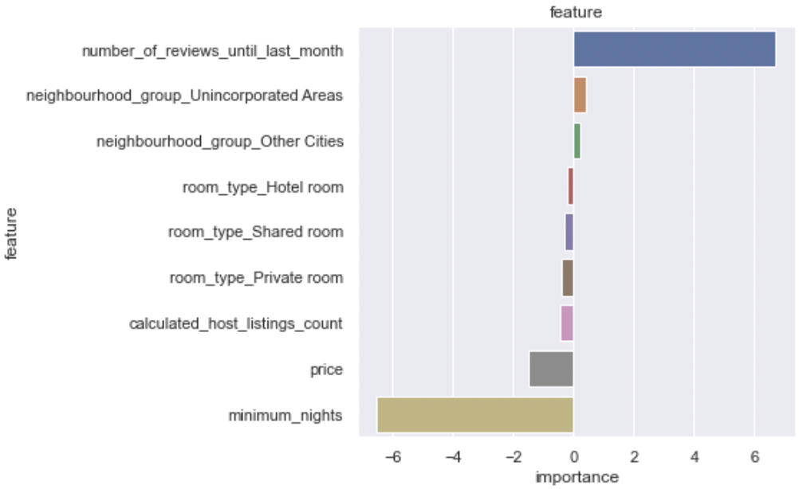
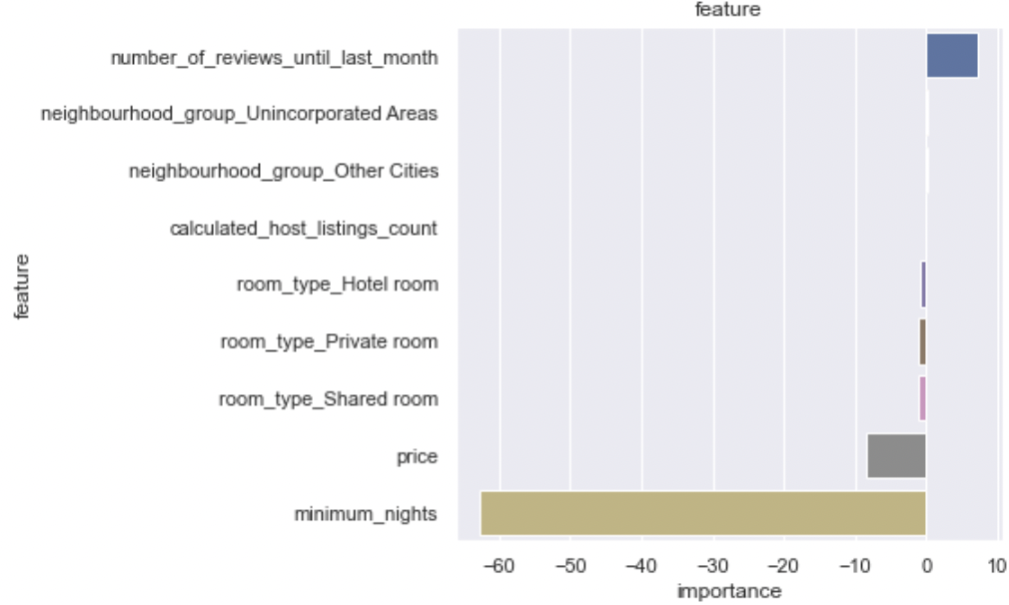
Important Factors
The Number_of_reviews_until_last_month, Price and Minimum_nights are Important Factors
Mothed1: Linear Regression
Method2: Logistic regression
month_review as dependent variable, more reviews means more successful
listings whose monthly reviews at the top 25% are considered as successful
* number_of_reviews_until_last_month: the total number of reviews until last month
The minimum_nights might be the causality of a listing's reviews.
As required minimum nights increase, the number of bookings that can be made for the listing is limited, which could ultimately lead to fewer reviews
The number of reviews until last month is more likely to be a covariate of a listing's success in Airbnb, rather than a causality.
The positive relationship could be because of room condition or the marketing efforts put forth by the host

Slide 12
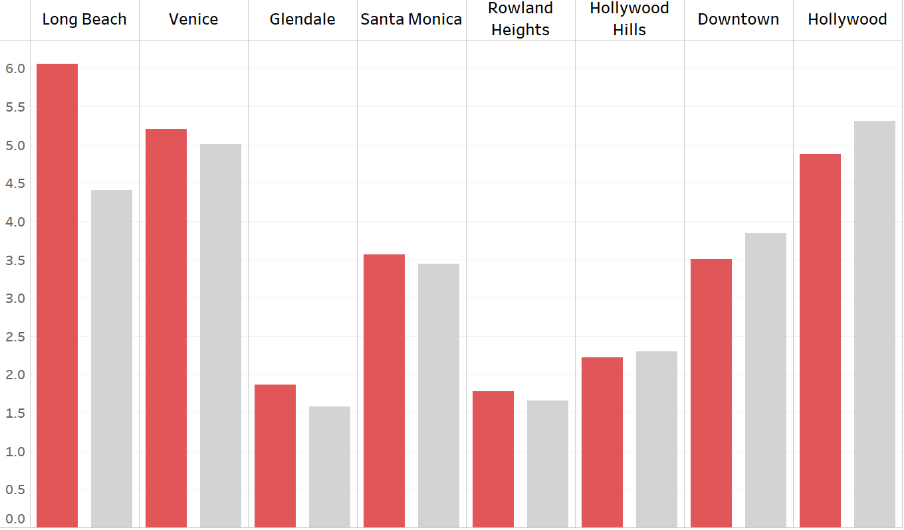

Location
Listings in broad areas may be more advantageous post-Covid
Locations with high listing volume may not lead to equally high successful listing rates
Long Beach, Venice, Glendale and Santa Monica have a relatively higher successful listing rate compared to their volume rate, probably because these areas are broad open and attract more guests post-Covid
1.65%
-0.43%
Successful listing rate in this location
Volume rate in this location
*sort by the difference between successful listing rate and volume rate

Slide 13
Thank You for Listening!

